Slide 1
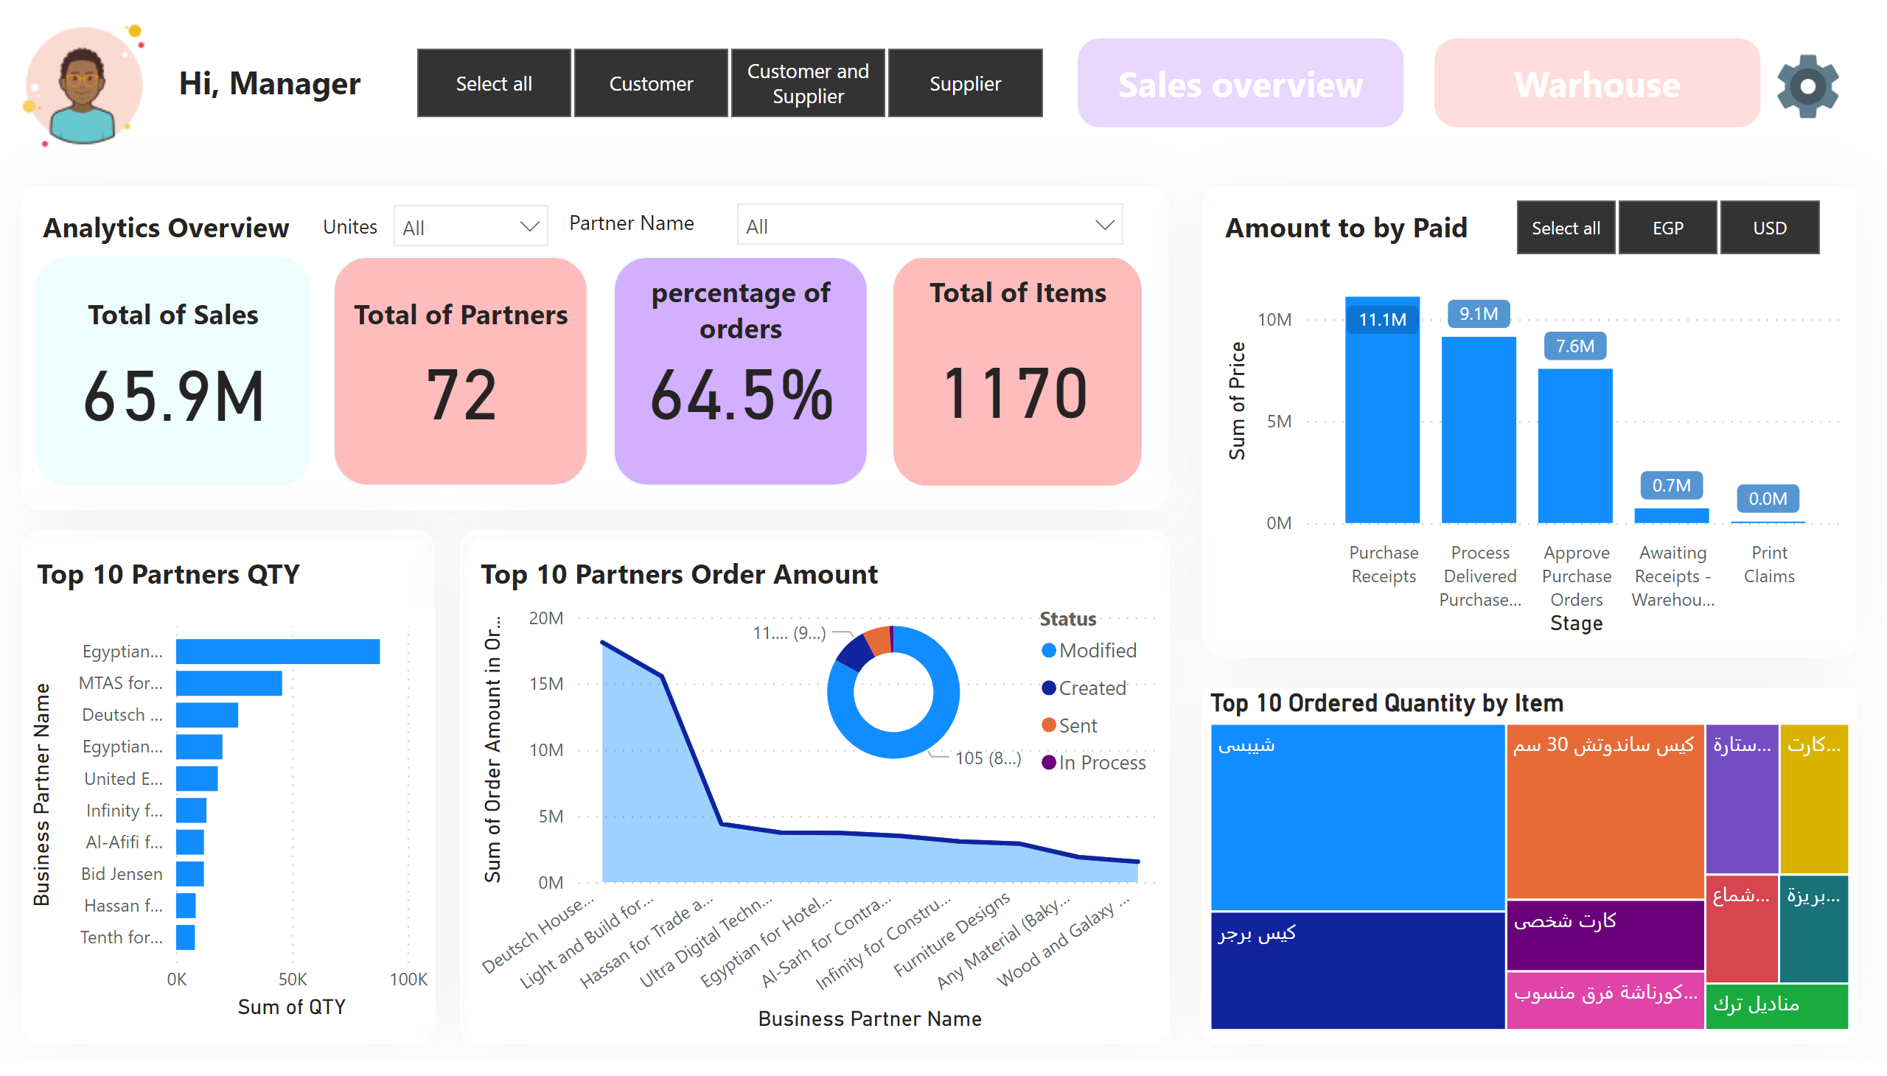
HomePage
Notes:
image
No alt text provided
textbox
No alt text provided
image
No alt text provided
shape
No alt text provided
textbox
No alt text provided
shape
No alt text provided
shape
No alt text provided
shape
No alt text provided
shape
No alt text provided
shape
No alt text provided
shape
No alt text provided
textbox
No alt text provided
shape
No alt text provided
textbox
No alt text provided
shape
No alt text provided
textbox
No alt text provided
shape
No alt text provided
actionButton
No alt text provided
actionButton
No alt text provided
slicer
No alt text provided
slicer
No alt text provided
slicer
No alt text provided
textbox
No alt text provided
textbox
No alt text provided
card
No alt text provided
textbox
No alt text provided
clusteredBarChart
No alt text provided
stackedAreaChart
No alt text provided
card
No alt text provided
textbox
No alt text provided
slicer
No alt text provided
lineStackedColumnComboChart
No alt text provided
Top 10 Ordered Quantity by Item
No alt text provided
card
No alt text provided
textbox
No alt text provided
donutChart
No alt text provided
card
No alt text provided
textbox
No alt text provided

Slide 2
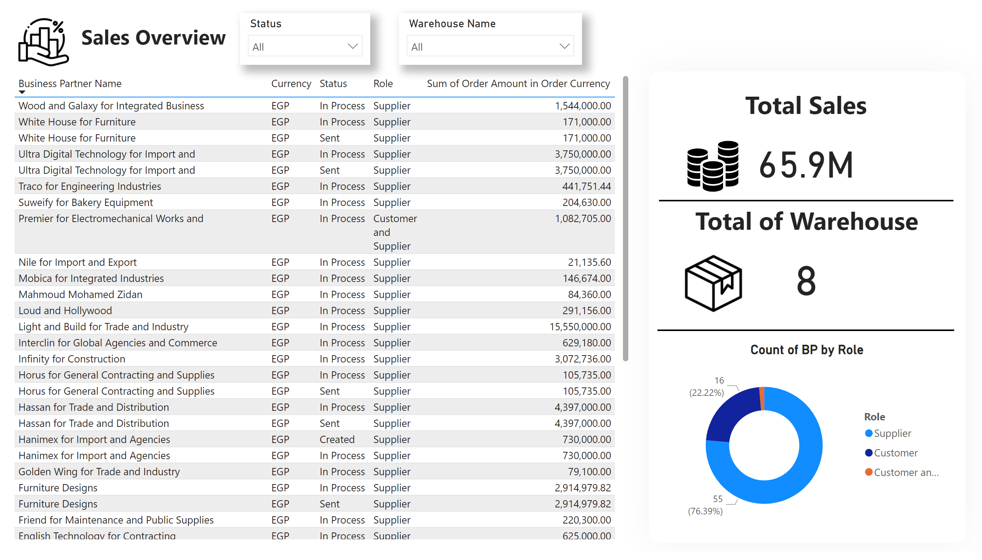
Sales overview
Notes:
textbox
No alt text provided
tableEx
No alt text provided
slicer
No alt text provided
slicer
No alt text provided
shape
No alt text provided
textbox
No alt text provided
card
No alt text provided
image
No alt text provided
Count of BP by Role
No alt text provided
card
No alt text provided
image
No alt text provided
textbox
No alt text provided
shape
No alt text provided
shape
No alt text provided
image
No alt text provided

Slide 3
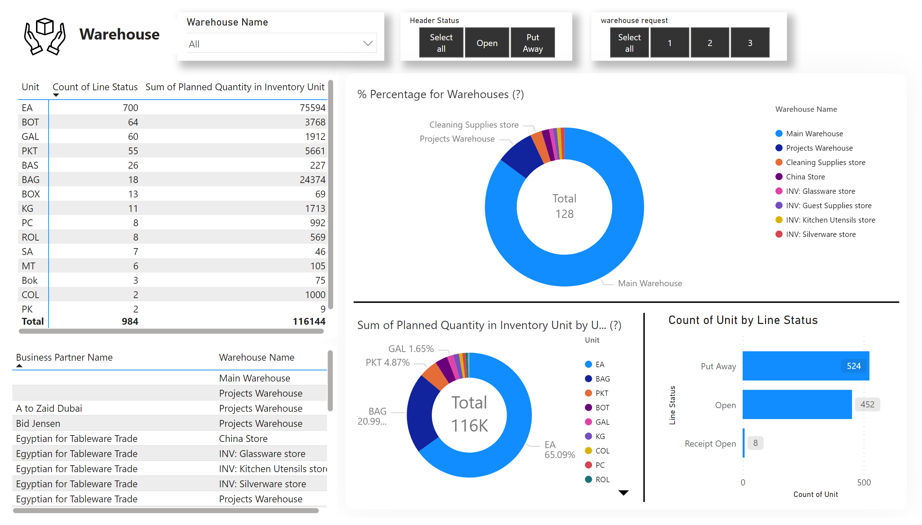
Warehouse
Notes:
slicer
No alt text provided
slicer
No alt text provided
slicer
No alt text provided
image
No alt text provided
textbox
No alt text provided
shape
No alt text provided
DonutChartGMO1461469098694
No alt text provided
shape
No alt text provided
pivotTable
No alt text provided
tableEx
No alt text provided
DonutChartGMO1461469098694
No alt text provided
clusteredBarChart
No alt text provided
shape
No alt text provided

